Slide 1
Deep learning neural networks approach for OCT image
Thitiya Seesan

Slide 2
OCT and machine learning
Classification
Segmentation

Slide 3
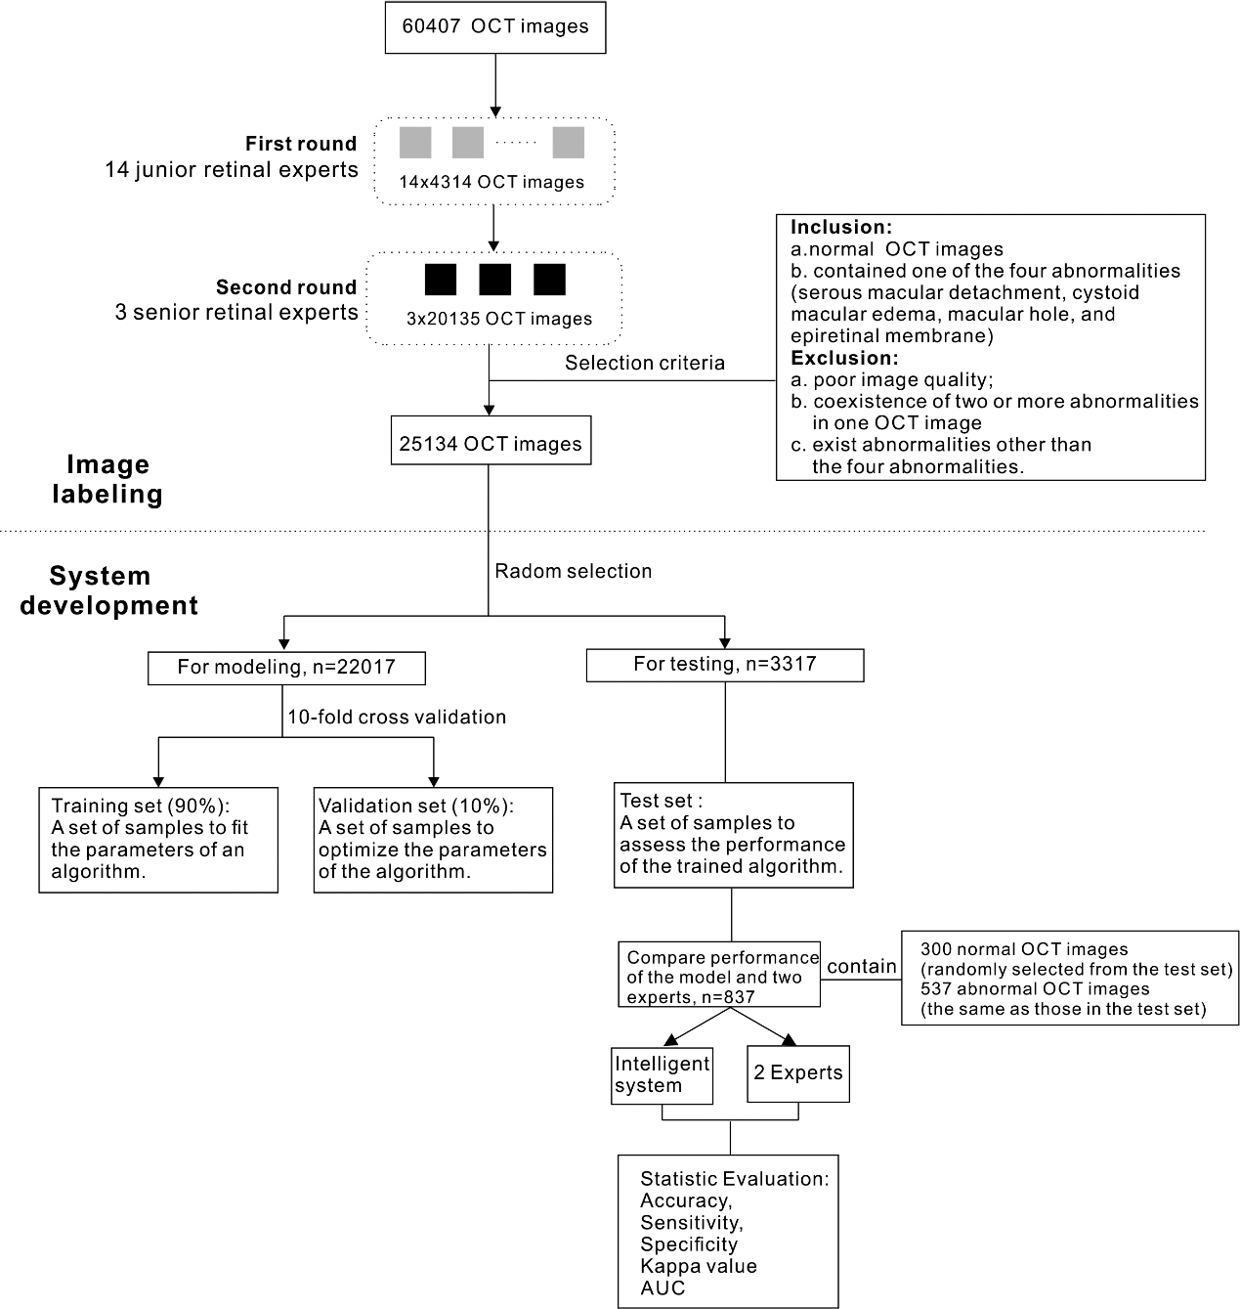
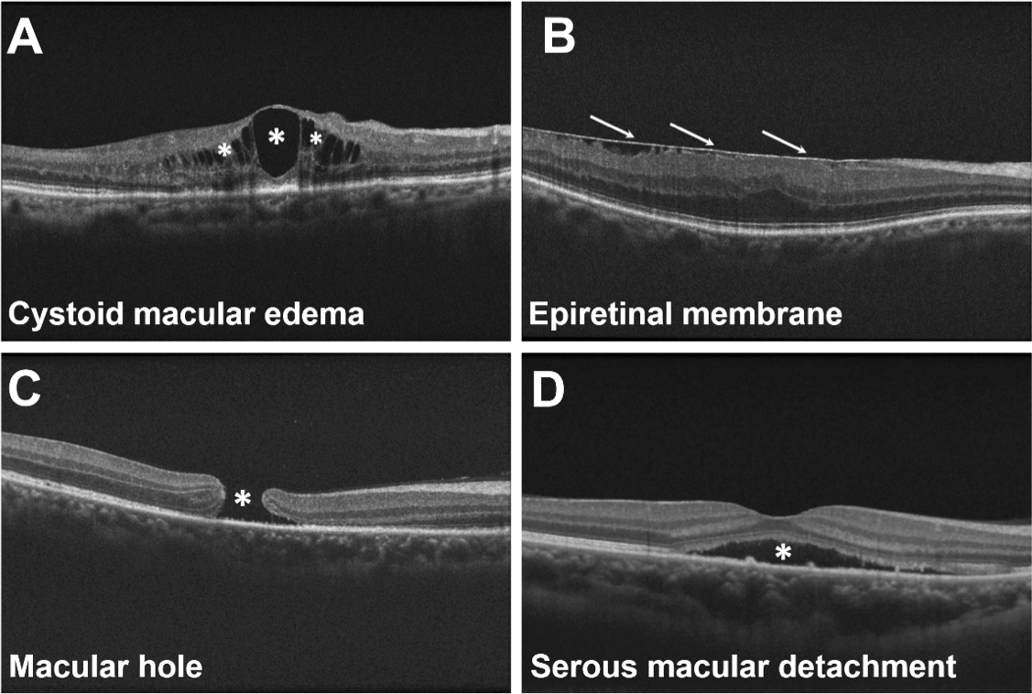
OCT image classification
Data Set
Image Labeling and Training Process
Evaluation
From: Deep Learning-Based Automated Classification of Multi-Categorical Abnormalities From Optical Coherence Tomography Images
Trans. Vis. Sci. Tech.. 2018;7(6):41. doi:10.1167/tvst.7.6.41

Slide 4
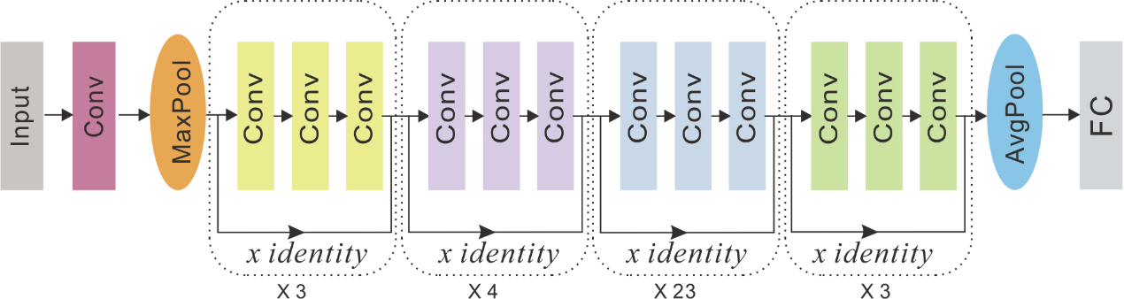
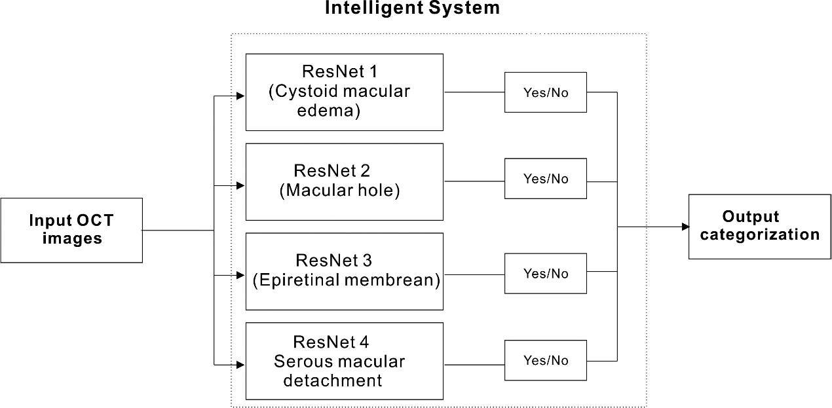
Model: ResNet
A diagram showing a 101-layer ResNet. Conv, convolutional layer; AvgPool, average pool; FC, fully connected layer.

Slide 5
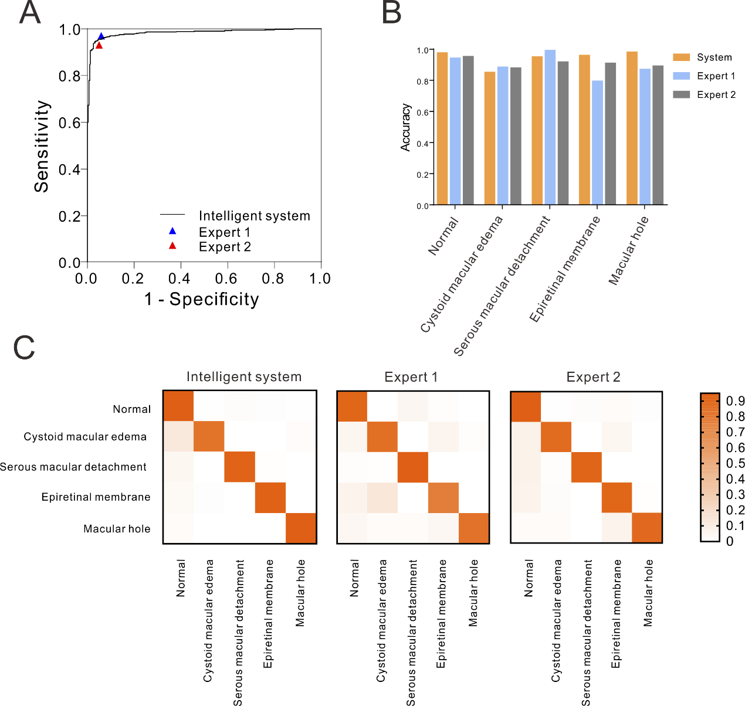
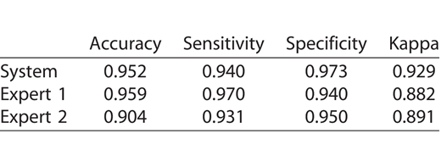
Statistical Evaluation: The AUC can be very useful for the quantitative assessment of a model.
Kappa value
(A) ROC curve for diseases detected by the system, with the operating points of the two experts shown for comparison. (B) A histogram comparing the specific accuracy of each category between the two experts and the system. (C) Three confusion matrixes for the intelligent system and the two experts' predictions, respectively.
Trans. Vis. Sci. Tech.. 2018;7(6):41. doi:10.1167/tvst.7.6.41

Slide 6
OCT image combined with machine learning
Classification
Segmentation

Slide 7
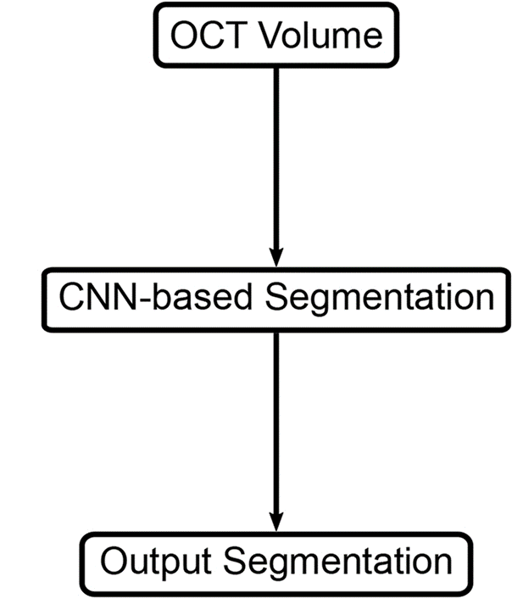
Segmentation of mouse skin layer in OCT
Identification of related pixels in an image to define a region
From: Segmentation of mouse skin layers in optical coherence tomography image data using deep convolutional neural networks
https://doi.org/10.1364/BOE.10.003484

Slide 8
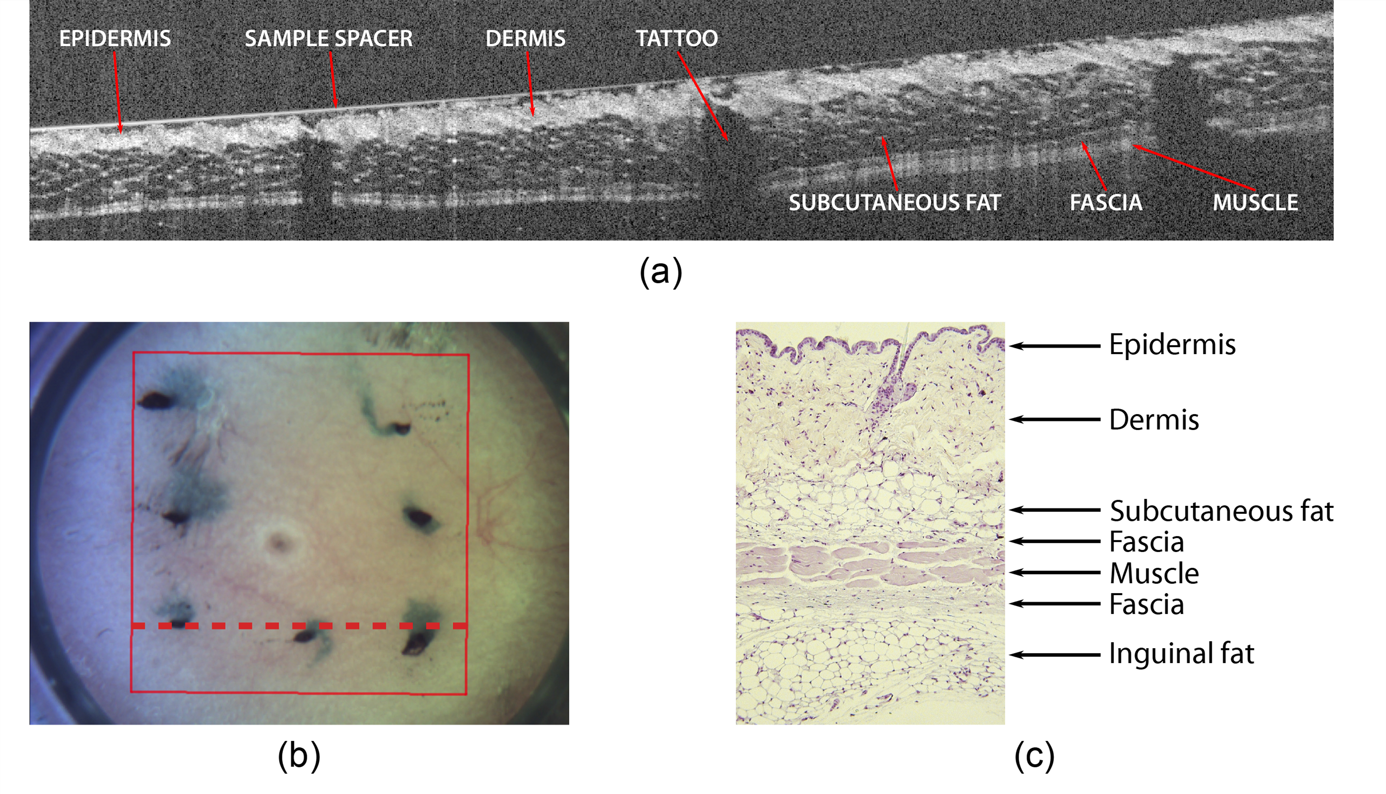
OCT scan of mouse skin of the inguinal area. (a) B-scan of inguinal mouse skin. Note that the sample spacer is visible as a bright horizontal line in the upper part of the image, whereby it is difficult to distinguish between epidermis and dermis at contact points. The red rectangle in the overview image (b) visualizes the field of view and the dashed line indicates the scan position. A histological section of mouse skin is given in (c).

Slide 9
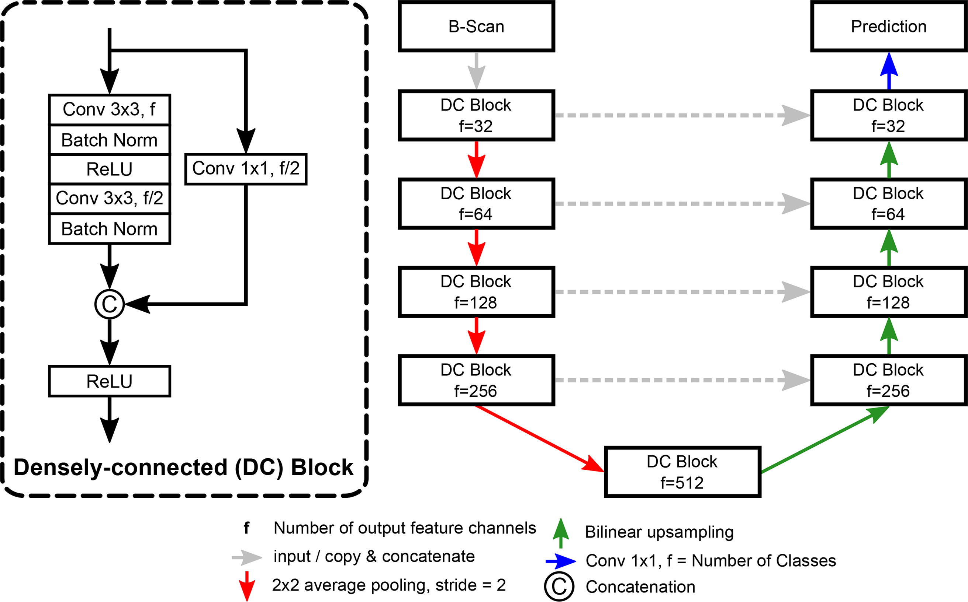
Model: U-Net
The CNN segments an OCT volume by processing each B-scan independently. After being processed, the predicted B-scan segmentations are merged into a single output volume.

Slide 10
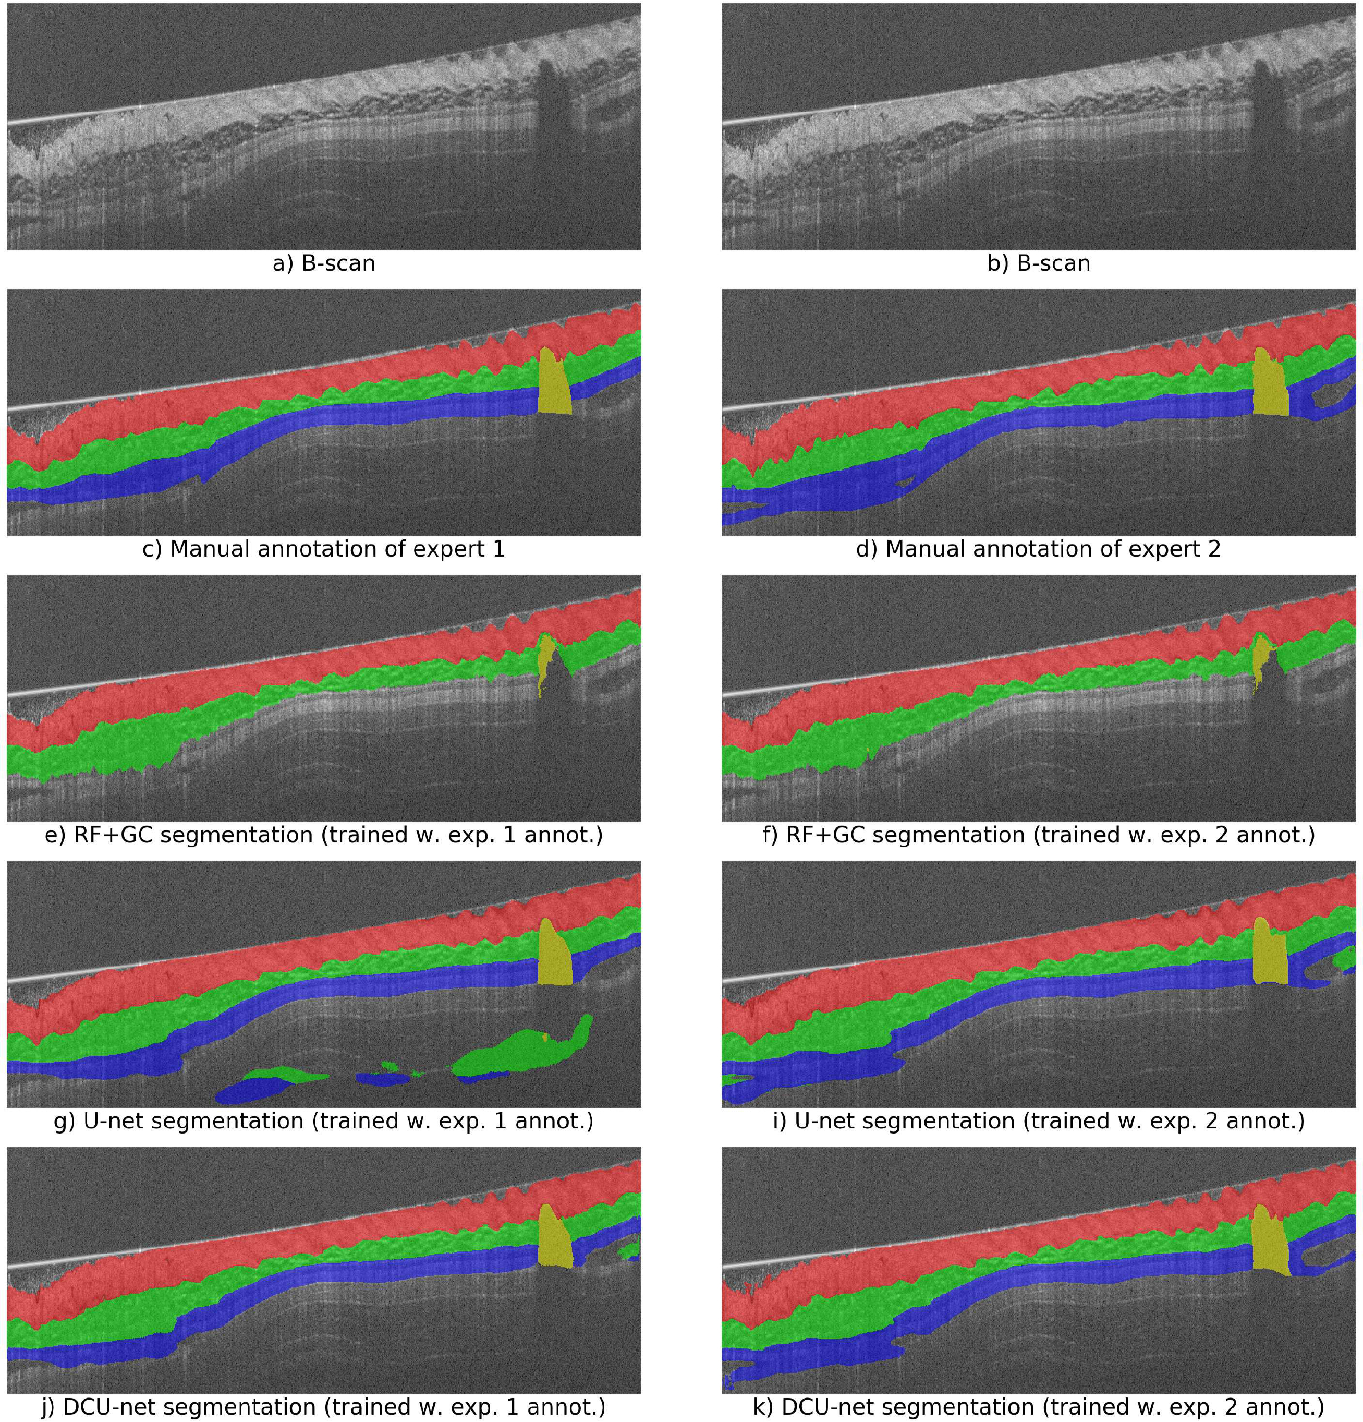
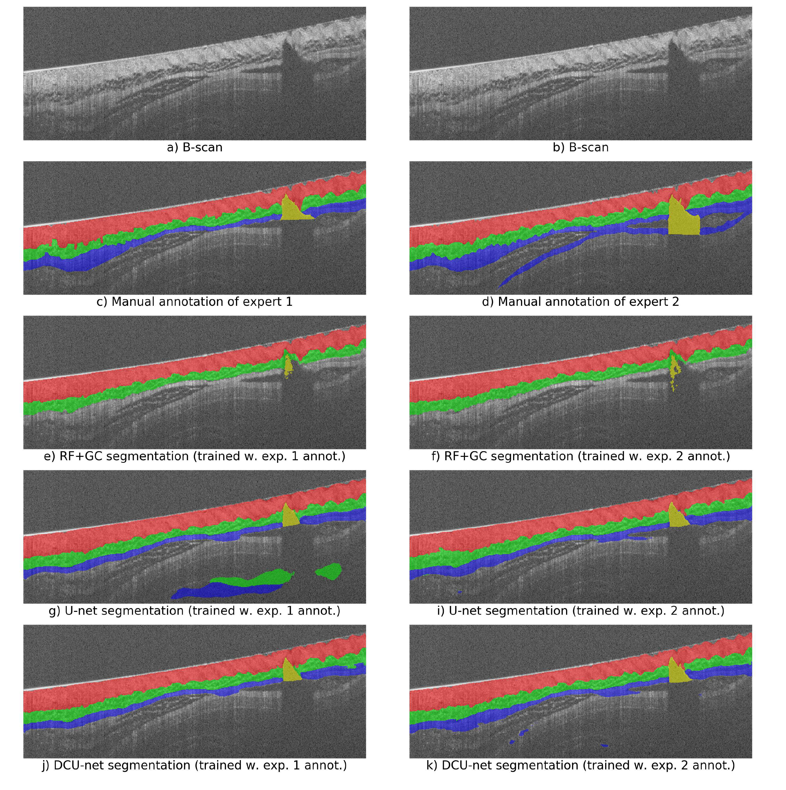
The segmentation results of the algorithms were visually examined and compared with the corresponding ground truth for qualitative analysis.

Slide 11
Conclusions
Deep Learning (DL) has shown clinically acceptable diagnostic performance in detecting many retinal diseases, abnormality localization, automatic diagnosis, and intuitive guiding.
Successfully combined machine learning with OCT images with high accuracy and confirmed the features seen inside by accuracy value.
For ophthalmologists, this provides convenient criteria for retinal disease and contributes to rapid diagnosis and building a database of abnormal images.

Slide 12
OCT image combined with machine learning
Classification
Segmentation
OCT image processing: Denoisiong

Slide 13
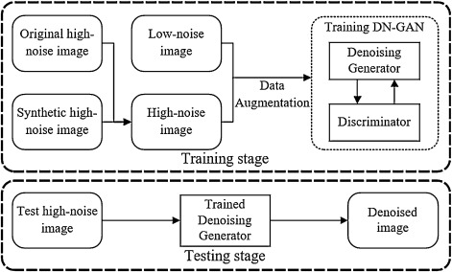
OCT image denoising
Reducing the speckle noise of OCT image.
Denoising generator is guided by the discriminator to learn the mapping between the noised image and ground truth, which can not only remove the speckle noise in the background and retina but also preserve the edges and details to enhance the image quality.

Slide 14
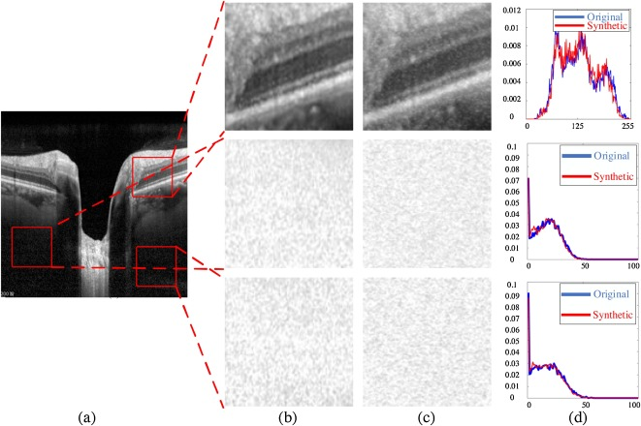
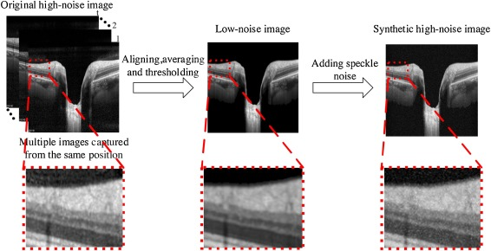
Pre-processing for training data
Get multiple images-captured from the same position.
Aligning, averaging, and thresholding.
Adding speckle noise.

Slide 15
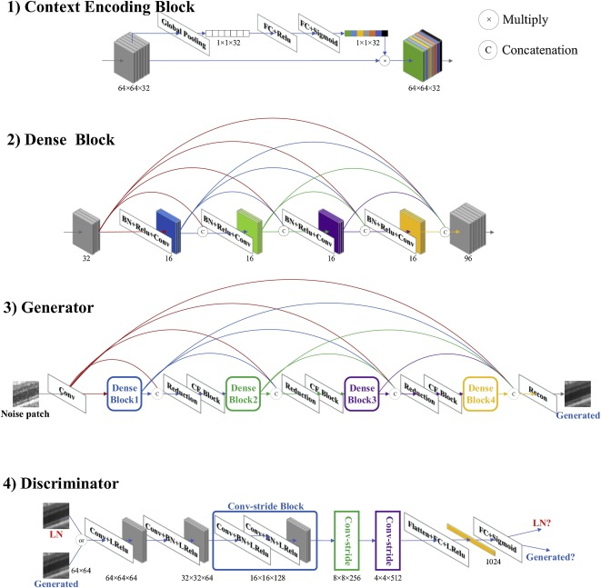
Training a DN-GAN
The datasets are collected on the ONH of 36 samples, in which each sample possessed more than 50 single-frame images.
Each dataset includes three image types, namely, LN, synthetic HN, and original HN images, consisting of 20 original and 20 synthetic HN images.
Then, the training datasets are cropped into small patches with size 64 pixels × 64 pixels.

Slide 16
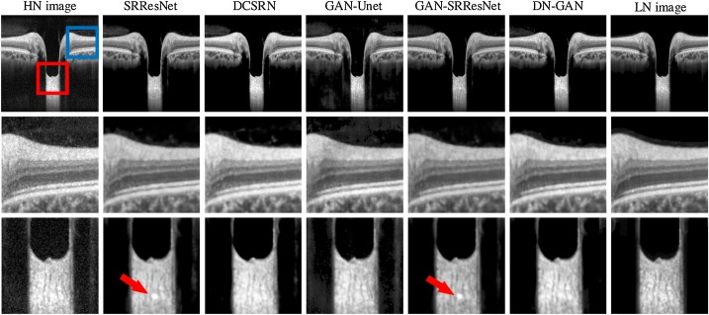
The denoising results by different models
The edges of the retina are unclear; in particular, the pore paths of the lamina cribrosa are blurred. Although GAN-UNet can restore the details effectively, much residual noise remained in the retina and background.
Fig. Original image (HN image) and reconstruction results by the SRResNet, DCSRN, GAN-UNet, GAN-UNet, GAN-SRResNet, DN-GAN, and the reference image (LN image). The middle row is the detail of retina in blue box and the bottom row is the detail of lamina cribrosa in red box. Best viewed with color and zoom-in.

Slide 17
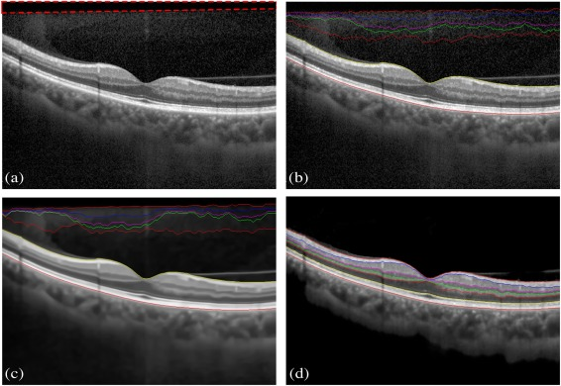
Traditional denoising methods, such as the BM3D algorithm, only reduce but not eliminate the grayscale gradient in the edge of the regions.
DN-GAN can remove the background noise and avoid this issue.
Compared with other GAN and non-GAN models, DN-GAN achieves the best denoising performance with fewer parameters, and the generated images are more realistic than those of the other models.
Fig. 9. Layer segmentation result. (a) Original image, (b) segmentation result without any pre-processing, and the results by the (c) BM3D, (d) DN-GAN. Best viewed with zoom-in.

